Slide 1

Notes:
Источник:

Slide 2
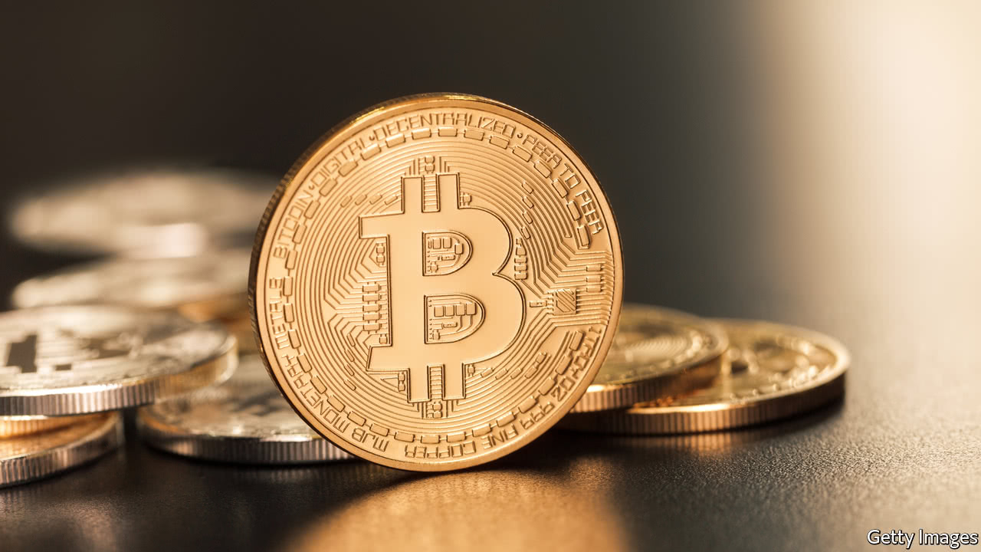
Have you ever…..?
bought or sold something on eBay or a similar site
lost your credit card or your wallet
saved for something for a long time
wasted money on something you’ve never used
won any money (e.g. in a lottery)
lent money to someone who didn’t pay you back

Slide 3

Improve my reading and speaking skills
Talk about money
Learn present perfect and Past simple tenses
Notes:
Источник:

Slide 4
Listen to a song about money and complete it with the words.
What is “Ka-Ching”?
credit card afford mall spend loan
greedy earn blow broke mortgage
“Ka-Ching”
We live in a ______ little world-- that teaches every little boy and girl To ________ as much as they can possibly-- then turn around and Spend it foolishly We've created us a ________ mess We _______ the money that we don't possess Our religion is to go and _______ it all So it's shoppin' every Sunday at the ______
[Chorus:] All we ever want is more A lot more than we had before So take me to the nearest store Can you hear it ring It makes you wanna sing It's such a beautiful thing--Ka-ching! Lots of diamond rings The happiness it brings You'll live like a king With lots of money and things When you're ______ go and get a ________ Take out another _________ on your home Consolidate so you can _________ To go and spend some more when you get bored [Repeat Chorus]
Notes:
Источник:

Slide 5
Now look at the words A-H in the song and match them with their meanings 1-10
A | afford | 1. | to give or pay money for something
B | mall | 2. | money that a person or a bank lands you
C | spend | 3. | to have enough money to buy something
D | loan | 4. | a shopping centre (US)
E | greedy | 5. | having no money (informal)
F | earn | 6. | a small plastic card you use to buy things
G | blow | 7. | to get money by working
H | broke | 8. | wanting more money, etc
I | mortgage | 9. | to spend a lot of money on something (informal)
H | credit card | 10. | the money the bank lends to you to buy a house
Notes:
Источник:

Slide 6
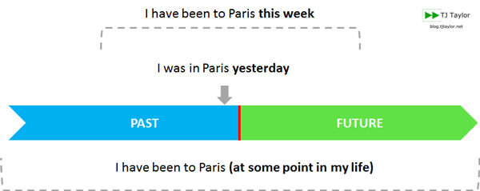
Present Perfect Vs. Past Simple
Present Perfect | Past Simple
General, not specific time in the past | Specific time in the past
Visible results in the present | Finished, does not influence the present
Resent actions
I have been to London twice in my life. | I was in London in 1994.
I have worked for this company for 10 years | I worked for this company 10 years ago.
I have lost my key. I cannot open the door now. | I lost my key yesterday. (I found the key or made new one. I have the key now)
Notes:
Источник:

Slide 7
Signal words
Present Perfect | Past Simple
just already up to now until now / till now ever / never (not) yet so far lately / recently before since for | yesterday ... ago in 1990 the other day last ... when
Have you ever been to Canada? | When did he go to Canada?
I have just phoned Mary. | I phoned Mary 2 minutes ago.

Slide 8
Change the verb into the correct form of the past simple or present perfect
Last night I (lose) my keys - I had to call my flatmate to let me in.
I _____ (lose) my keys - can you help me look for them?
I ______ (visit) Paris three times.
Last year I _______ (visit) Paris.
I ________ (know) my great grandmother for a few years - she died when I was eight.
I ________ (know) Julie for three years - we still meet once a month.
I __________ (play) Hockey since I was a child - I'm pretty good!
She ___________ (play) hockey at school but she didn't like it.
Sorry, I _________ (miss) the bus - I'm going to be late.
I ___________ (miss) the bus and then I _________ (miss) the airplane as well!
Last month I ________ (go) to Scotland.
I'm sorry, John isn't here now. He _________ (go) to the shops.
We _________ (finish) this room last week.
I _________ (finish) my exams finally - I'm so happy!
Yesterday, I _________ (see) all of my friends. It was great.
I __________ (see) Julie three times this week.
She _________ (live) in London since 1994.
She __________ (live) in London when she was a child.
I _________ (drink) three cups of coffee today.
I ___________ (drink) three cups of coffee yesterday.

Slide 9
1. Read the conversation. What are they arguing about?
2. Read the conversation again and put the verbs in the present perfect or the past simple. Then listen and check.
David: I haven’t seen (seen) those shoes before. Are they new?
Kate: Yes. I _______(just buy) them. Do you like them?
David: They’re OK. How much ______ they _______ (cost)?
Kate: Oh, not much. They ________ (be) a bargain. Under 100 Pounds.
David: You mean 99.99. That isn’t cheap for a pair of shoes. Anyway, we can’t afford to buy new clothes at the moment.
Kate: Why not?
David: __________ you ____________ (see) this?
Kate: No. What is it?
David: The phone bill. It __________ (arrive) this morning. And we ___________ (not pay) the electricity bill yet.
Kate: Well, what about the iPad you __________ (buy) last week?
David: What about it?
Kate: You _______________ (not need) a new one. The old one __________ (work) perfectly well.
David: But I ________ (need) the new model.
Kate: Well, I __________ (need) some new shoes.
Notes:
Источник:

Slide 10
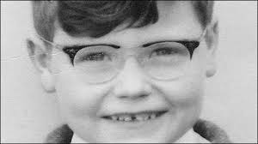
The millionaire with a secret
Jeff Pearce was a successful businessman – but he had a secret: he couldn’t read or write.
His name is not really Jeff. His mother changed it because he could never spell his real name, James, and she thought Jeff was easier.
Pearce was born in Liverpool in the 1950s, in a very poor family. At school, all the teachers thought he was stupid because he couldn’t learn to read or write – at that time, not many people knew about dyslexia. But there was something that he was good at: selling things. Pearce’s first experience as a salesman was when he was a boy, and he and his mother used to go door-to-door asking for old clothes that they could sell in the market. He instinctively knew what people wanted, and it soon seemed that he could make money from anything. His mother always believed in him and told him that one day he would be successful and famous.
In 1983, when he already owned a small boutique, he decided to invest £750 in leather trousers, and to sell them very cheaply in his shop. ‘It was a bit of a gamble, to tell you the truth,’ he says. But Liverpool loved it, and there were photos of shoppers sleeping in the street outside his boutique on the front page of the local newspaper. The first day the trousers went on sale, the shop took £25,000.

Slide 11
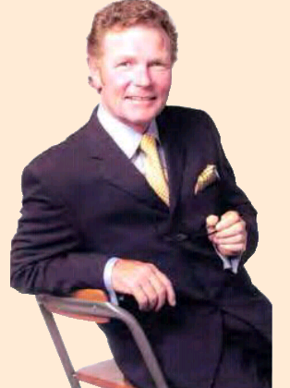
Jeff became a millionaire, but later he lost most of his money in the recession of the Nineties. He was almost 40, and he was broke again. He even had to go back to selling clothes in the market. But he never gave up, and soon he set up a new business, a department store, called Jeff’s, which again made him a millionaire.
However, success didn’t mean anything to Jeff because he still couldn’t read or write. Even his two daughters did not realize that their father couldn’t read. When one of them asked him to read her a bedtime story he went downstairs and cried because he felt so ashamed. At work he calculated figures in his head, while his wife Gina wrote all the cheques and read contracts.
In 1992 Pearce was awarded a Businessman of the Year prize for the best clothes store in Liverpool. It was at this moment that he told his friends and
colleagues the truth, and decided to write a book about his
experience. But first he had to learn to read and write. He went to
evening classes, and employed a private teacher, but he found it
very difficult because of his dyslexia. Finally, with the help of a
ghostwriter*, his autobiography, A Pocketful of Holes and Dreams,
was published, and became a best-seller. Recently, he was woken in
the middle of the night by someone knocking on his front door. It
was his daughter to whom he hadn’t been able to read a bedtime
story all those years earlier. She had come to tell him that she had
just read his book. ‘Dad, I’m so proud of you,’ she said – and burst
into tears in his arms.
Notes:
*A ghost-writer is somebody who writes a book for another person

Slide 12
How did he become so rich?
Why is his success surprising?
How did he make his daughter proud of him?
What do you think you can learn from Jeff’s story?
Number the events in the order in which they happened.
A __ He became a millionaire again.
B __ He learnt to read and write.
C __ He lost all his money.
D __ He sold old clothes in the market.
E __ He opened a department store.
F __ He won an important prize.
G __ He opened a small clothes shop.
H __ He became a millionaire.
I __ He sold clothes in the market again.
J __ He wrote his autobiography.
K __ His shop was on the front page of a newspaper.

Slide 13
Look at the highlighted words and phrases related to money and business. Try to work out the meaning from the context.
Complete the questions with one of the words and phrases. Then answer the questions.
When was the last __________ in your country? How long did it last (has it lasted)?
O you know anybody who works as a ________? What does he(she) sell?
If you were completely ________, who would you ask to lend you some money?
Have you ever bought something the first day it ______? What?
Do you know anybody who has ______ on their own? Is it successful?
millionaire
broke
recession
set up a new business
figure
contract
cheque
salesman
make money
boutique
gamble
go on sale

Slide 14

Talk about money
Use Past Simple and Present Perfect tenses
Use new words:
broke set up a new business recession
cheque gamble went on sale

